Slide 1
Secure your servers in time with JIT and JEA
Jaap Brasser

Slide 2


Jaap Brasser
MVP
Blogger
Speaker
@Jaap_Brasser
JaapBrasser.com/about

Slide 3
Agenda
What is JIT
What is JEA
Demo - JEA Configuration
Demo - JEA Administrative Endpoints
Wrap up & Questions

Slide 4
What is JIT
Privileged Access Management (PAM)
Requirements:
External forest
Microsoft Identity Management
2012R2 Domain Functional Level
Azure AD Premium

Slide 5
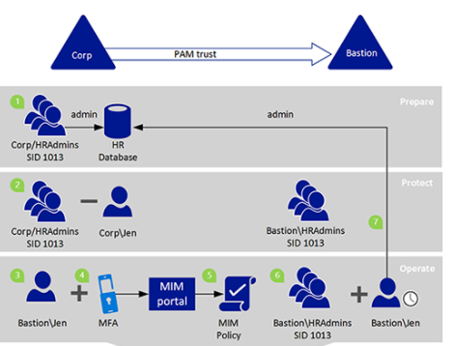
PAM Architecture

Slide 6
What is JEA
Just Enough Administration
Secure PowerShell access to critical systems
Reduce the number of Administrators
Extensive logging of Administrator activity

Slide 7
Implementing JEA
Deploy and configure pre-requisites
WMF 5.1
Enable PowerShell remoting
Configure PowerShell logging
PowerShell cmdlets to generate configurations

Slide 8
JEA Components
Role Capabilities .psrc
Configures capabilities
Session Configurations .pssc
Determines user mapping to roles
Language modes

Slide 9
Demo Create JEA Configuration

Slide 10
Demo summary
Create a Role Capability File
Deploy Role Capability File
Create Configuration File
Register Configuration
Update Role Capability

Slide 11
Demo Create JEA AD Management configuration

Slide 12
Demo summary
Create configuration for AD management
Validated security of the configuration
Show the logging capabilities

Slide 13
Wrap up
JIT can and should co-exist with current AD
JEA has extensive features
Enable PowerShell logging
More possibilities for automation

Slide 14

Questions

Slide 15
Next session 18:00 – 18:45
Azure Stack; everything you always wanted to know
Mark Scholman & Ruud Borst

